Slide 1
Multilayer Perceptrons
TexPoint fonts used in EMF.
Read the TexPoint manual before you delete this box.: AAAAAAAAA

Slide 2
Announcements
Practice problems for the exam will be posted later this week.
The first exam is on October 10 (Thursday of next week) in class.

Slide 3
Overview
Neural networks are a class of ML algorithms that can be applied to
solve just about any problem
For many problems, NNs achieve state-of-the-art performance, e.g., object recognition, speech recognition, machine translation
Today: Feedforward neural networks, in particular, the multilayer perceptron

Slide 4
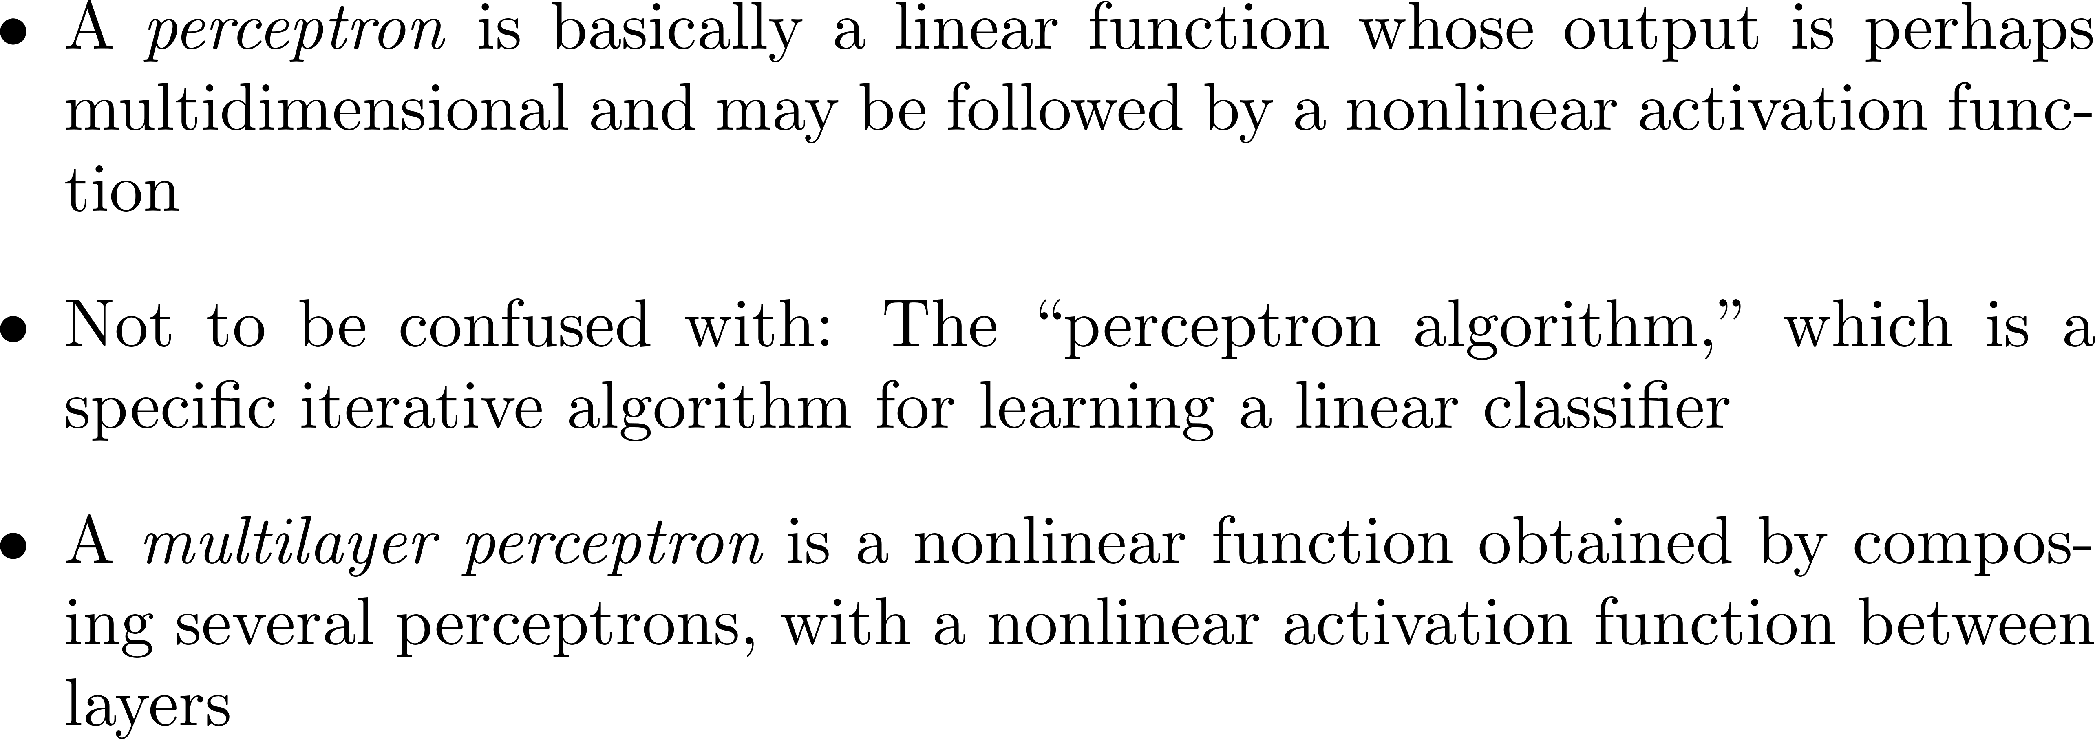
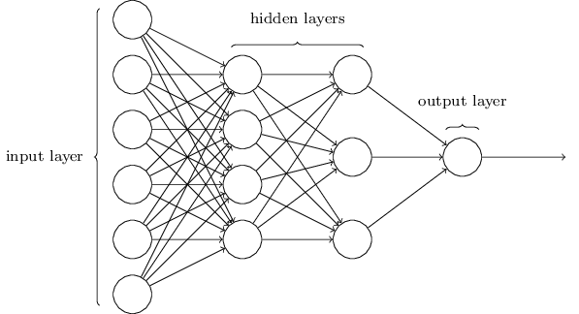
Multilayer Perceptrons

Slide 5
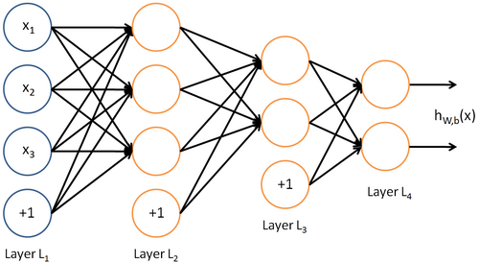
MLP Architectures
User needs to specify
Number of hidden layers
Number of nodes per hidden layer
Nonlinear activation function
Bias at each layer?

Slide 6
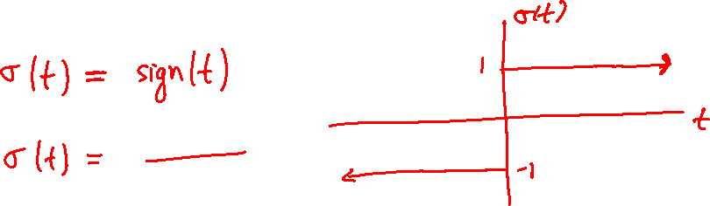
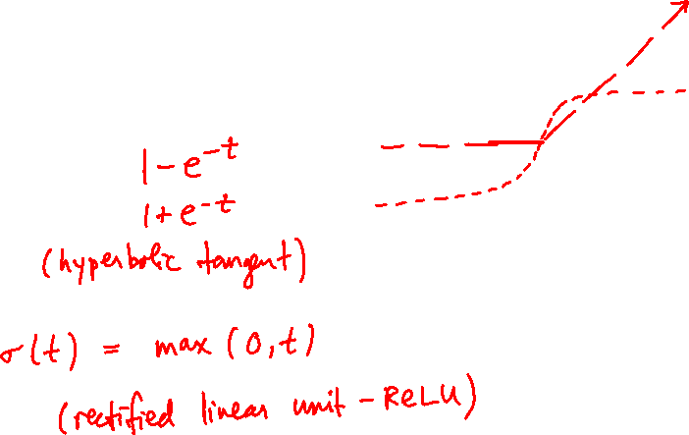
Activation Functions

Slide 7
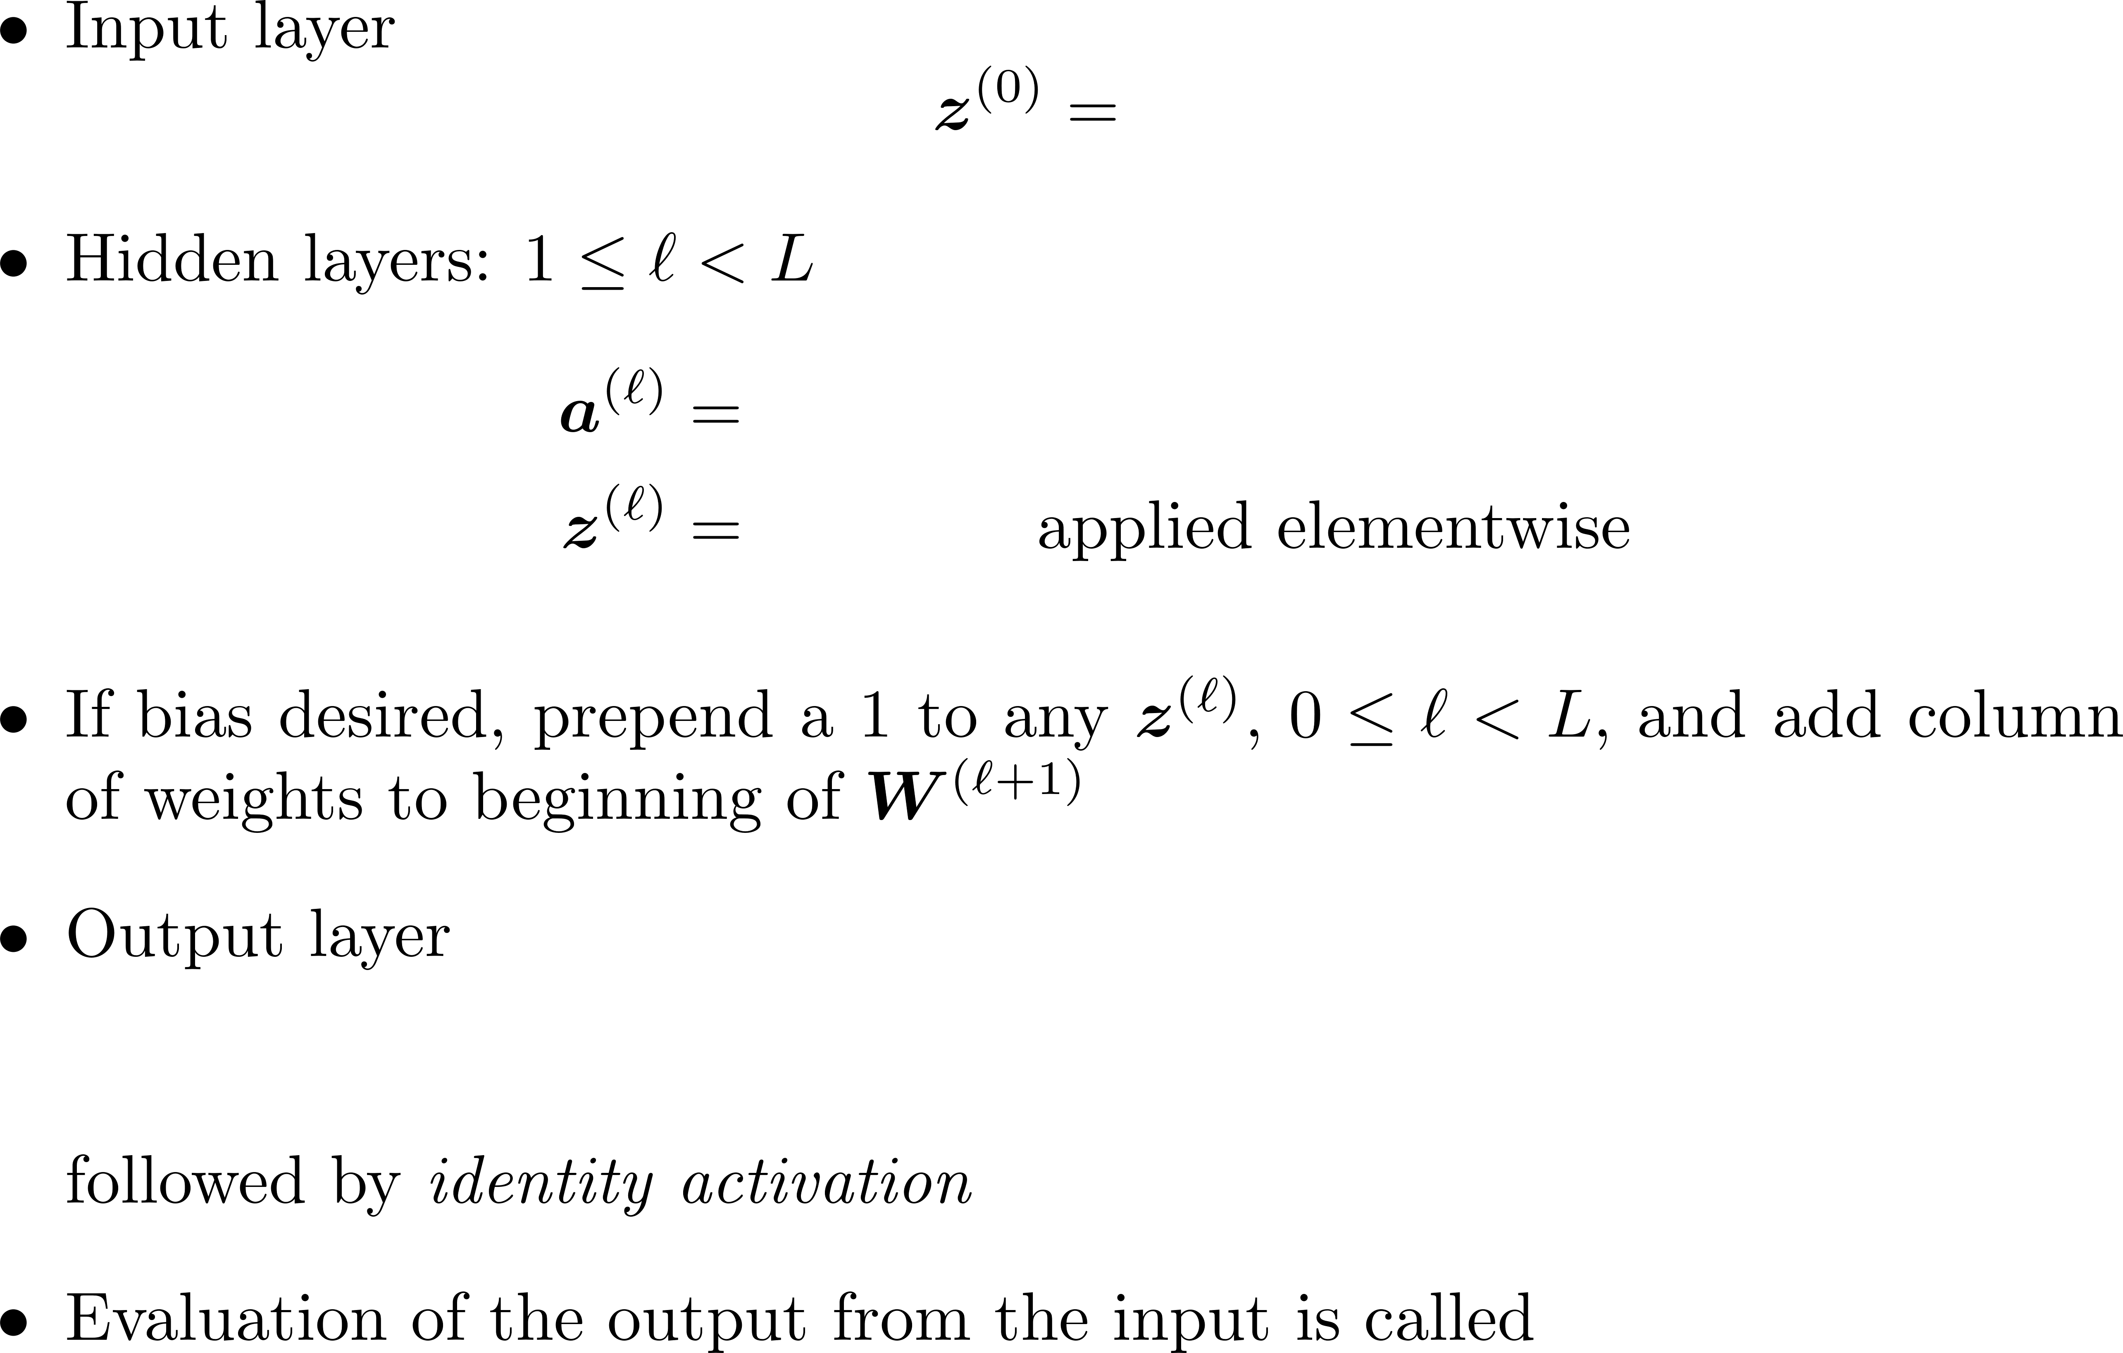
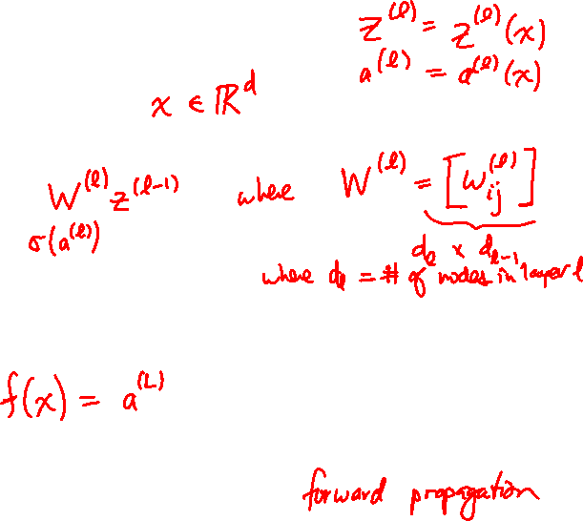
Notation

Slide 8
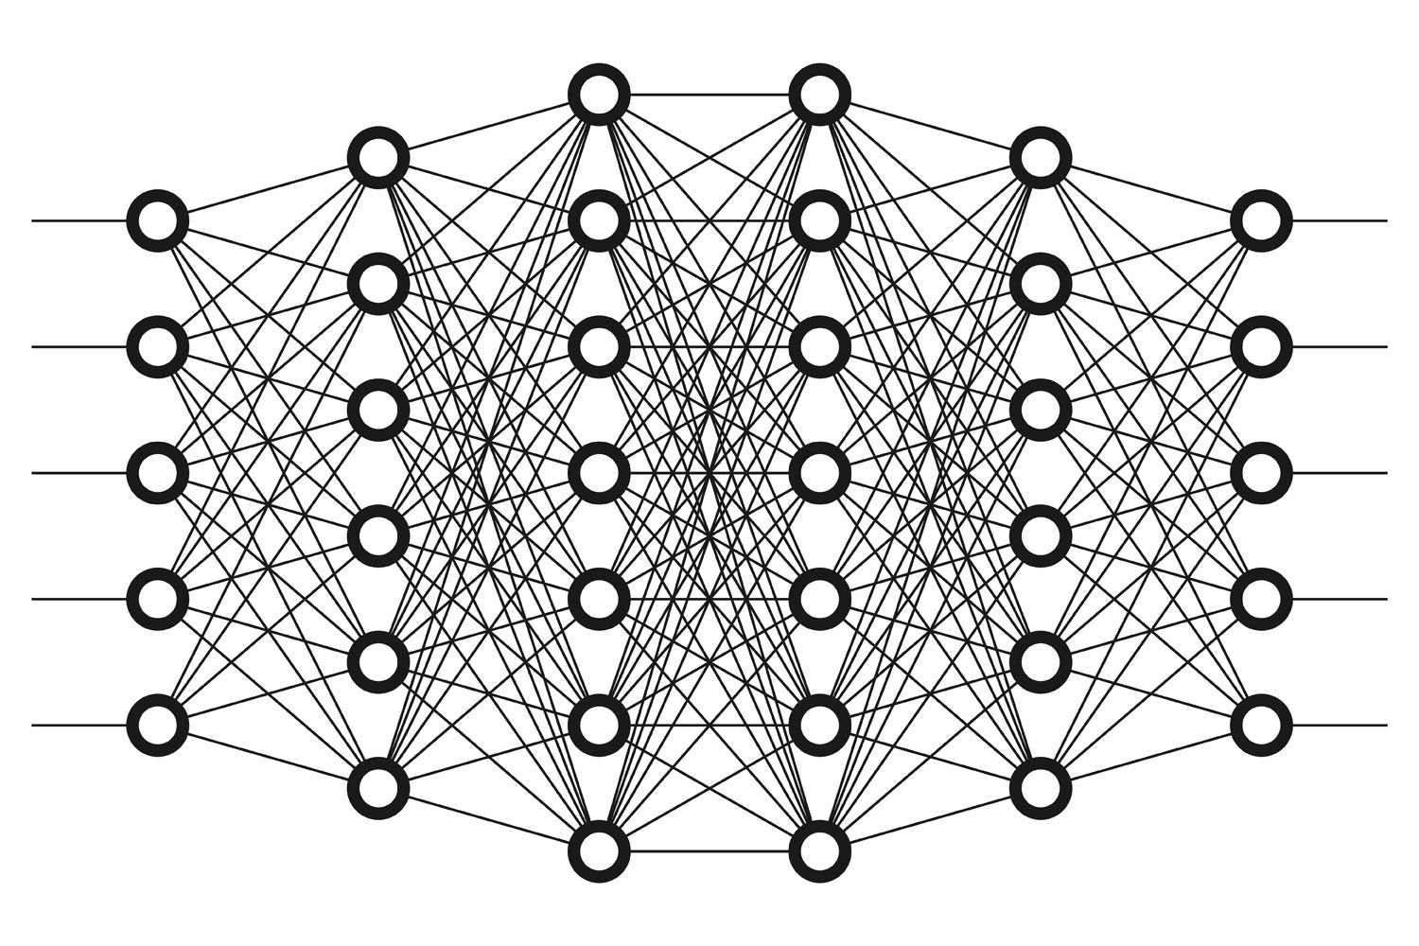
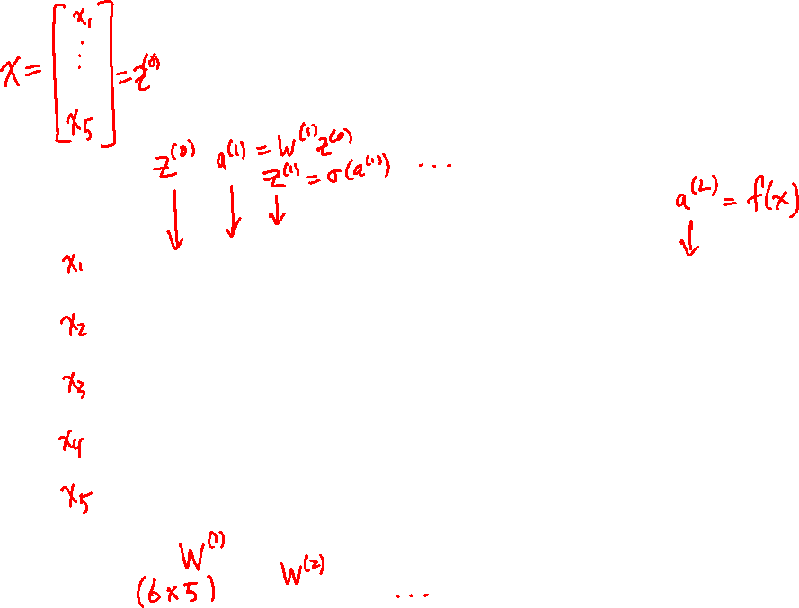
Illustration of Notation

Slide 9
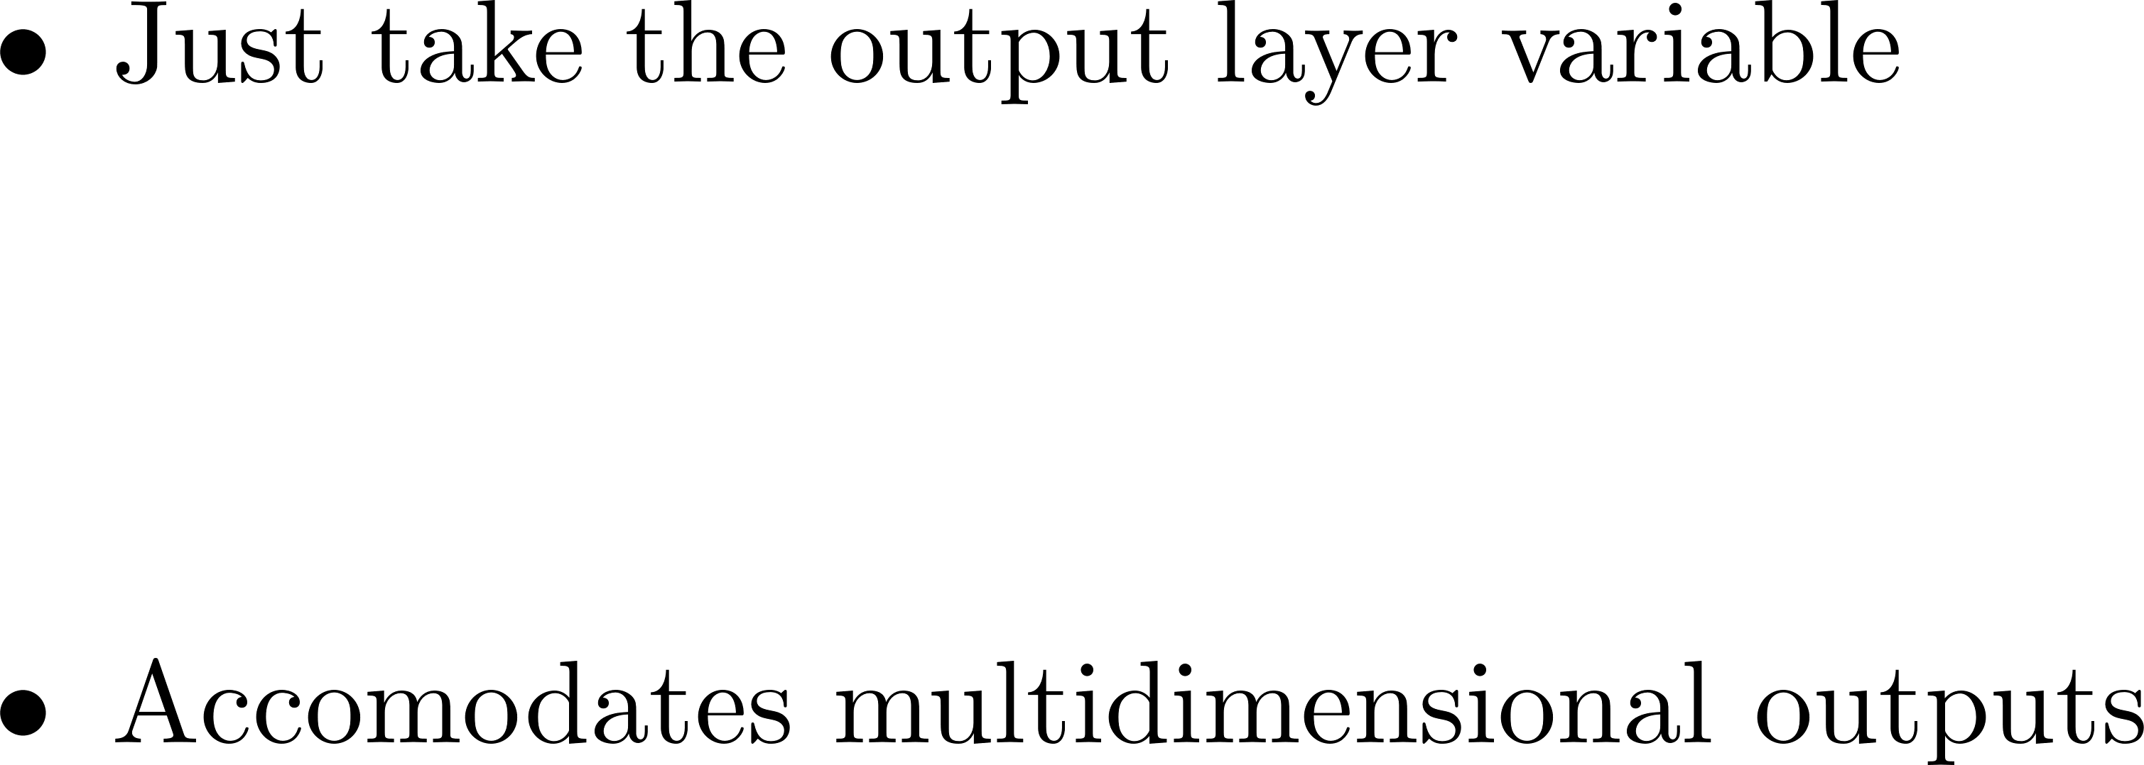

Final Predictor: Regression

Slide 10
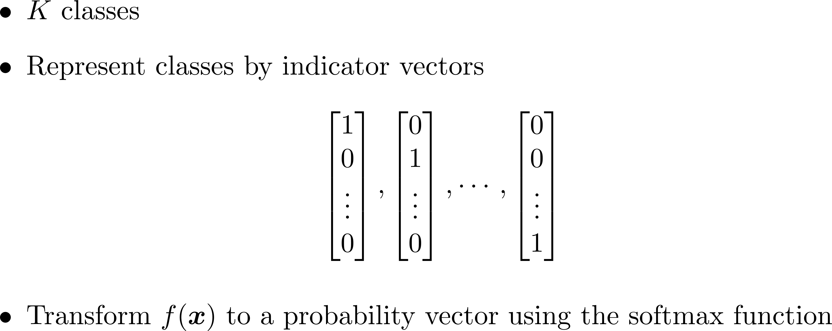
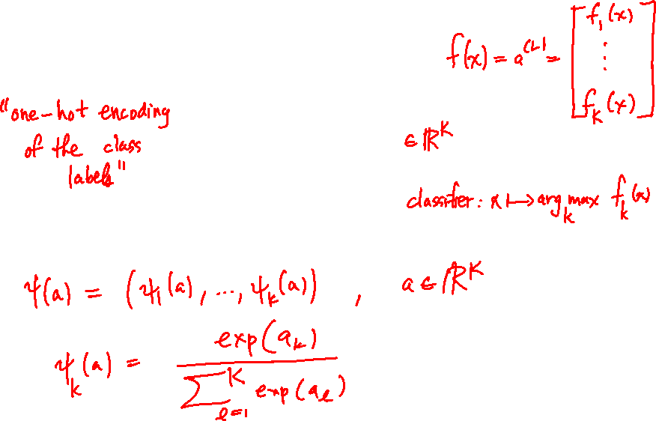
Final Predictor: Classification

Slide 11
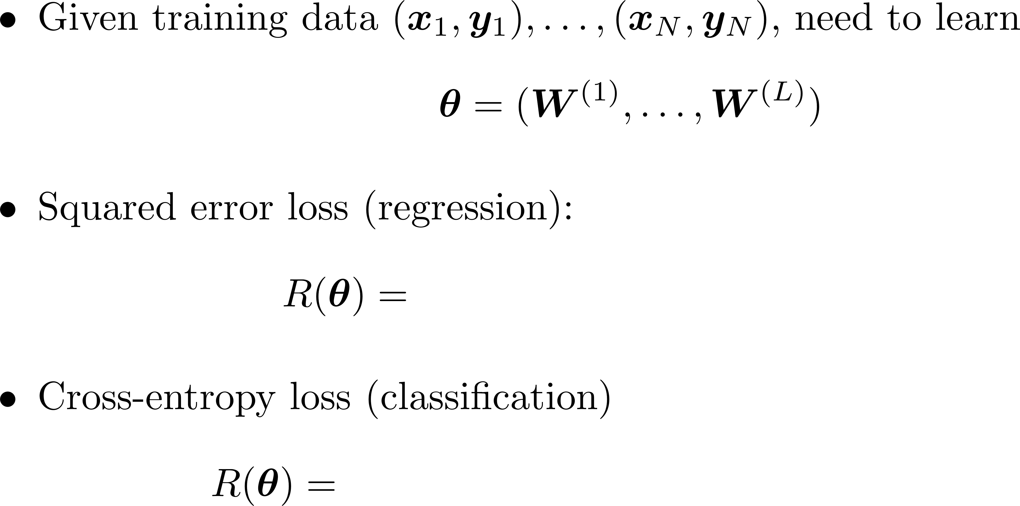
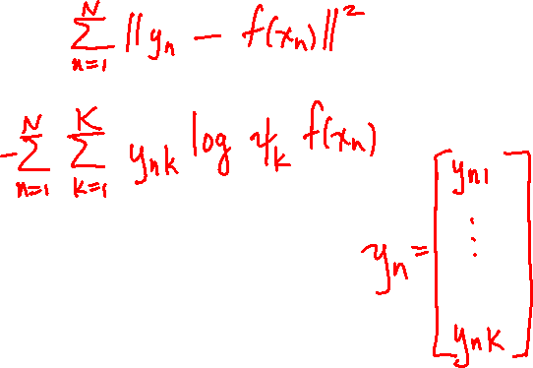
Empirical Risk

Slide 12
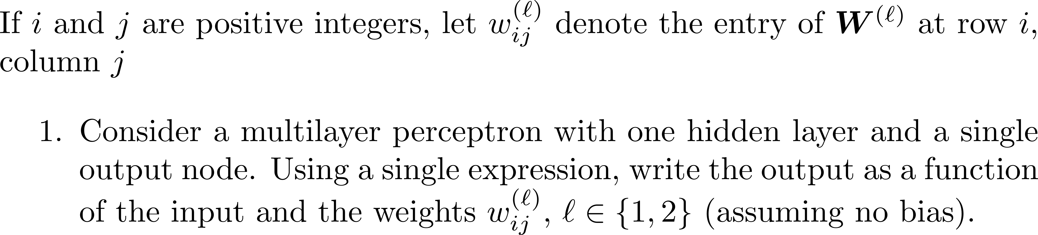
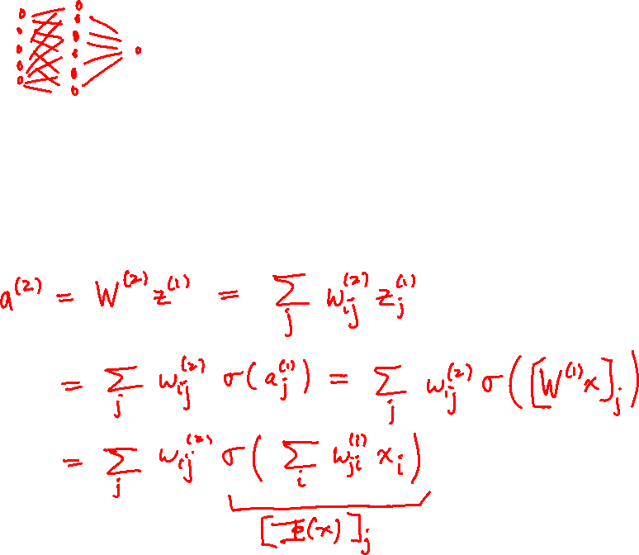
Exercise

Slide 13
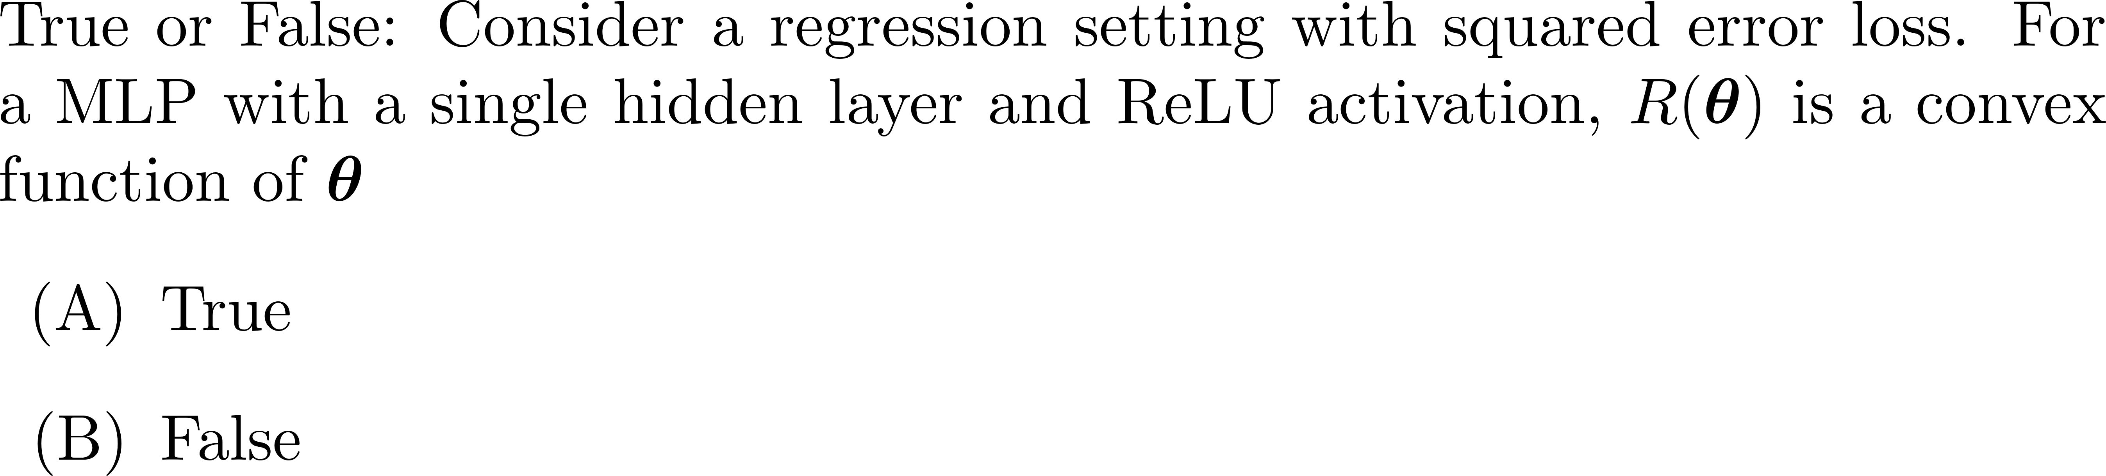
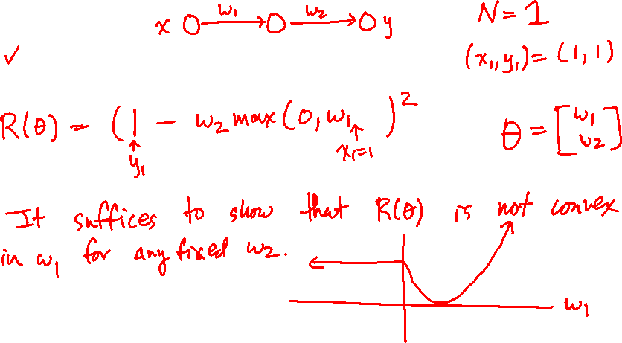
Poll

Slide 14
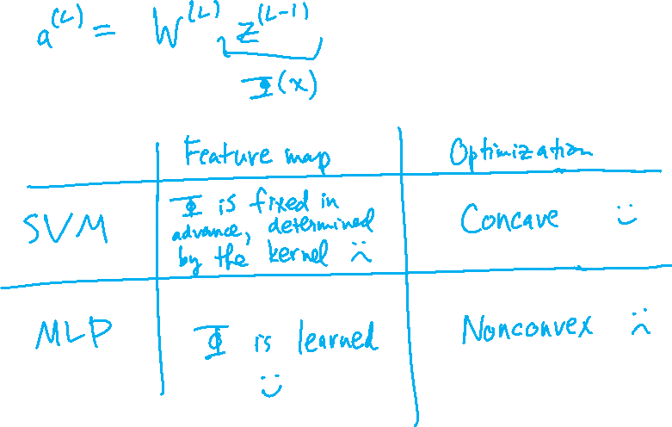
MLPs vs Kernel Methods

Slide 15

Backpropagation

Slide 16
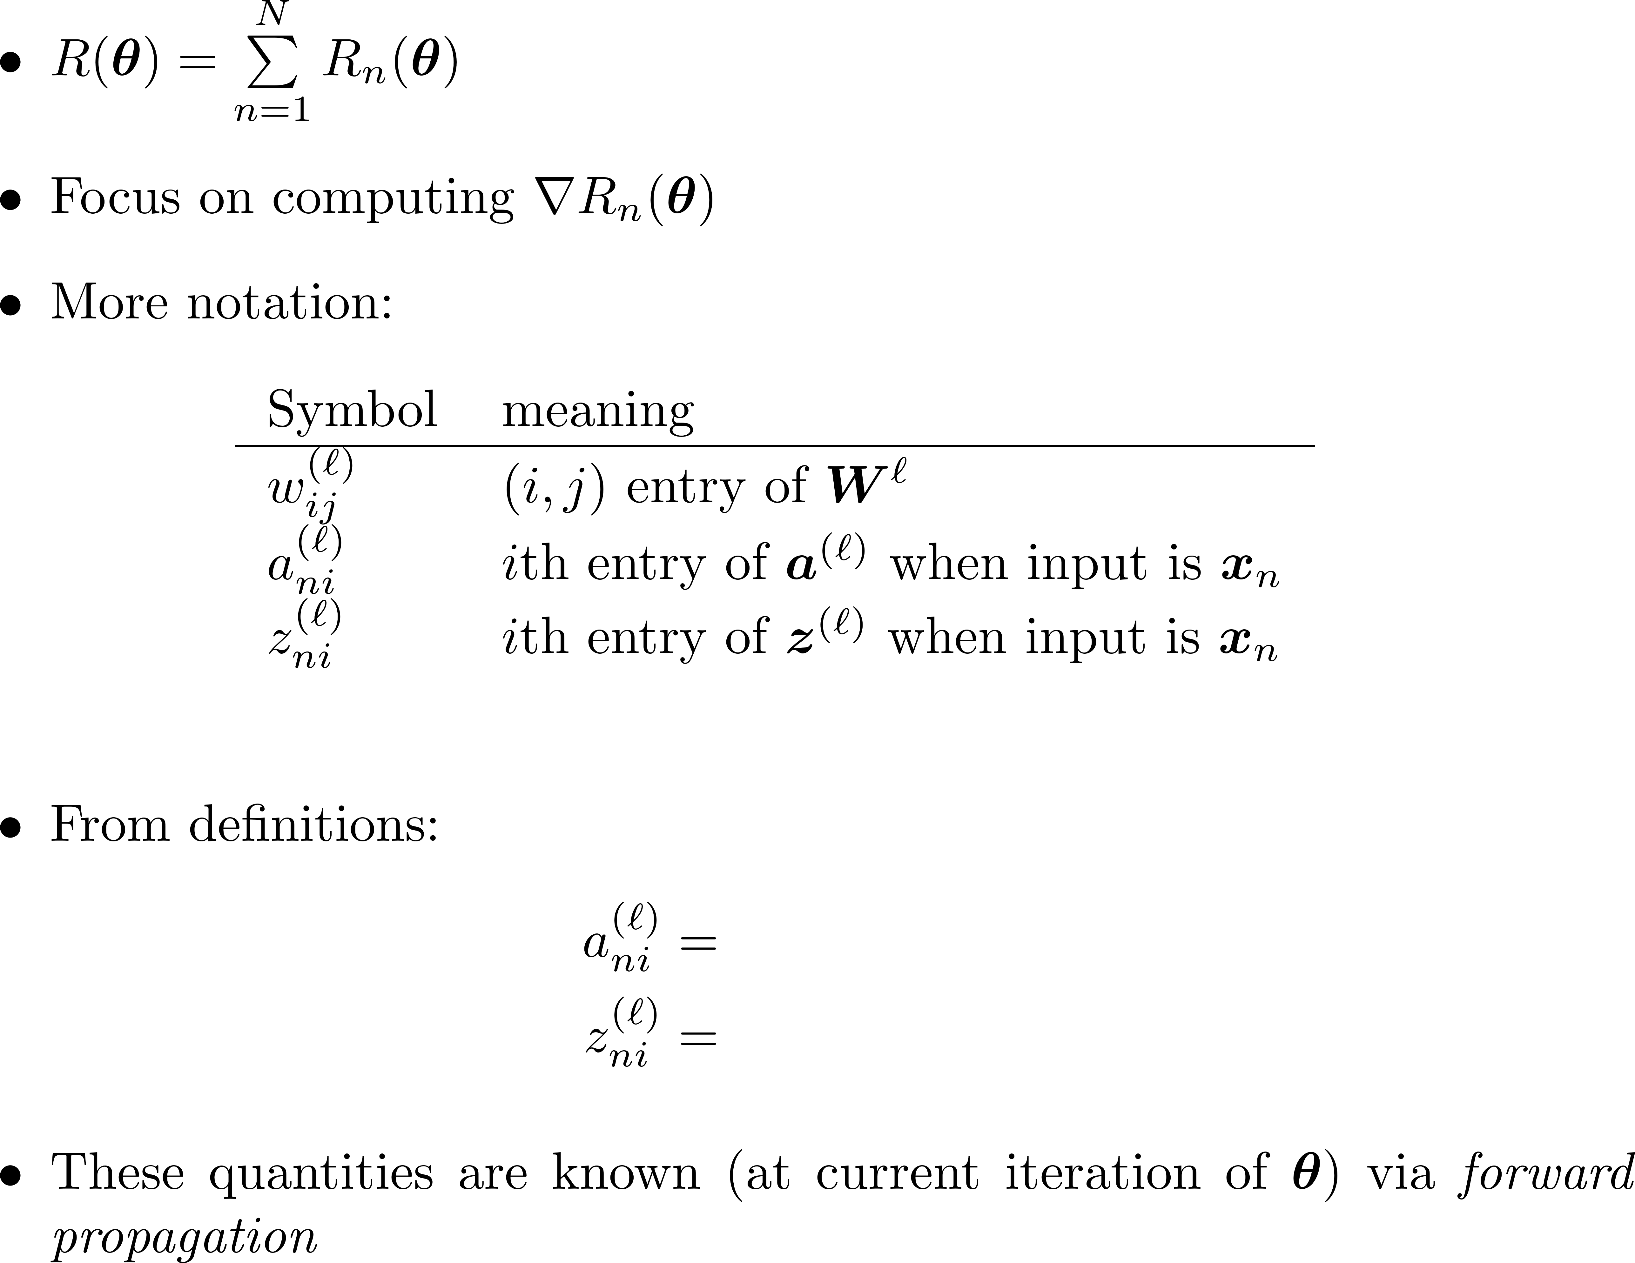
Backprop

Slide 17
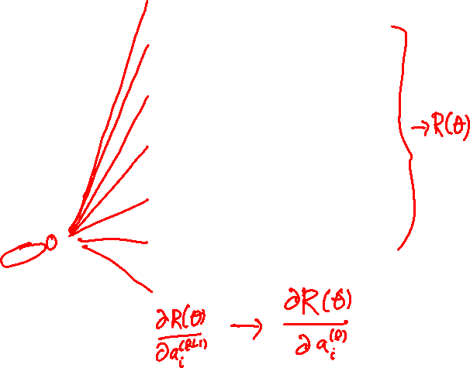
Illustration of Gradient Formulas

Slide 18
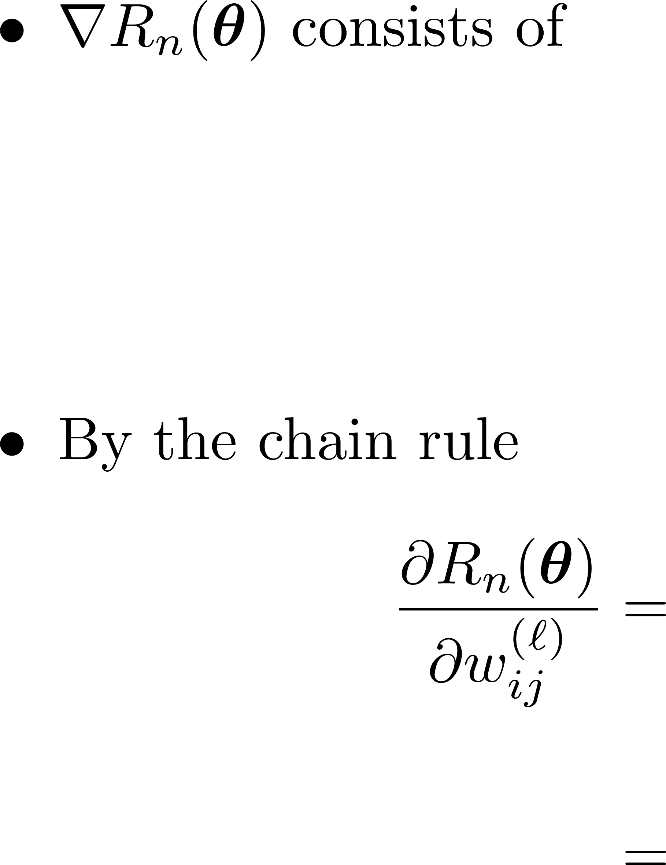
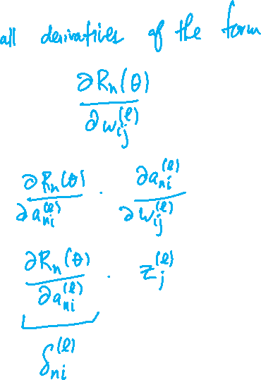
Backprop

Slide 19
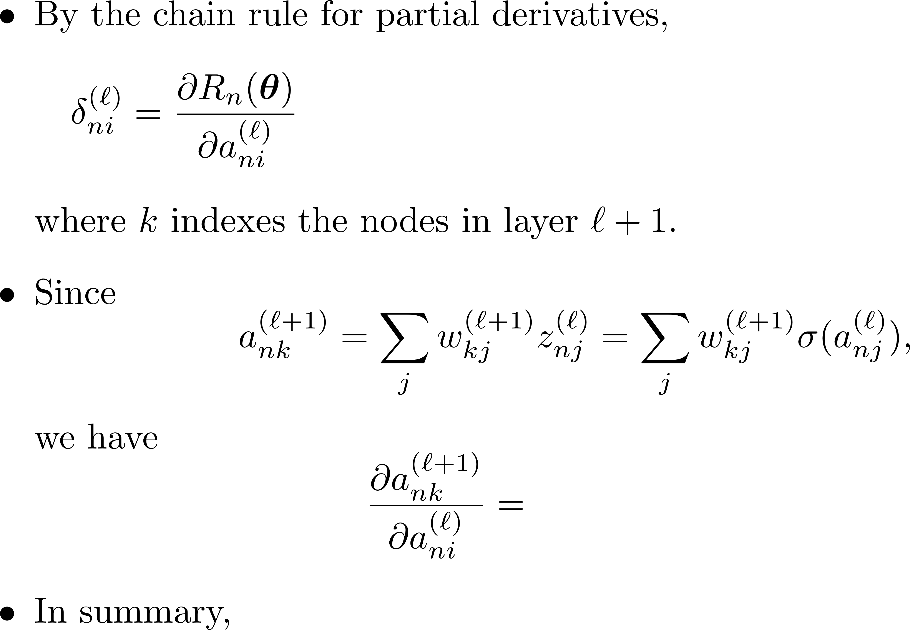
Backprop

Slide 20
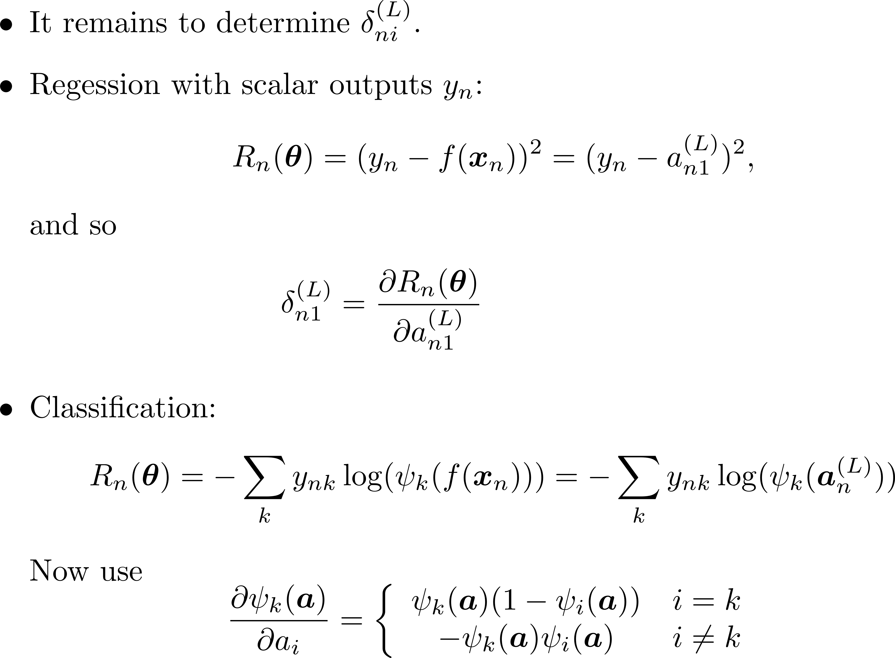
Backprop

Slide 21
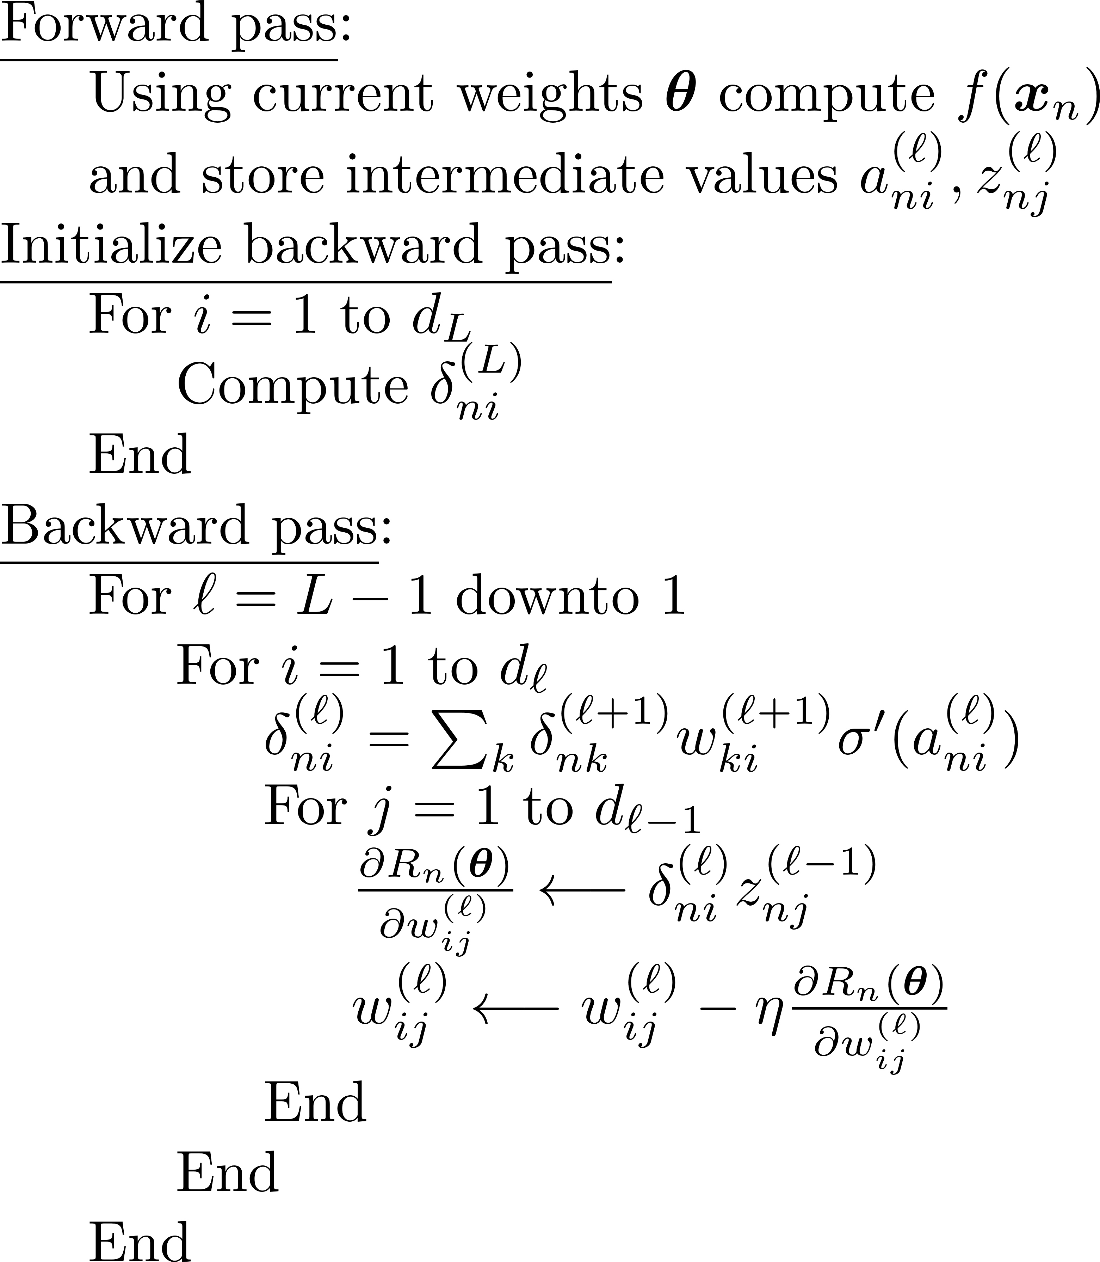
Backprop

Slide 22
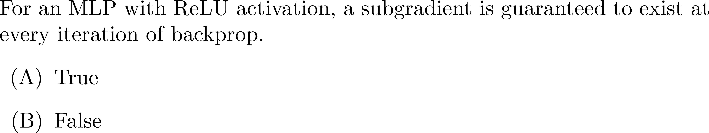
Poll

Slide 23
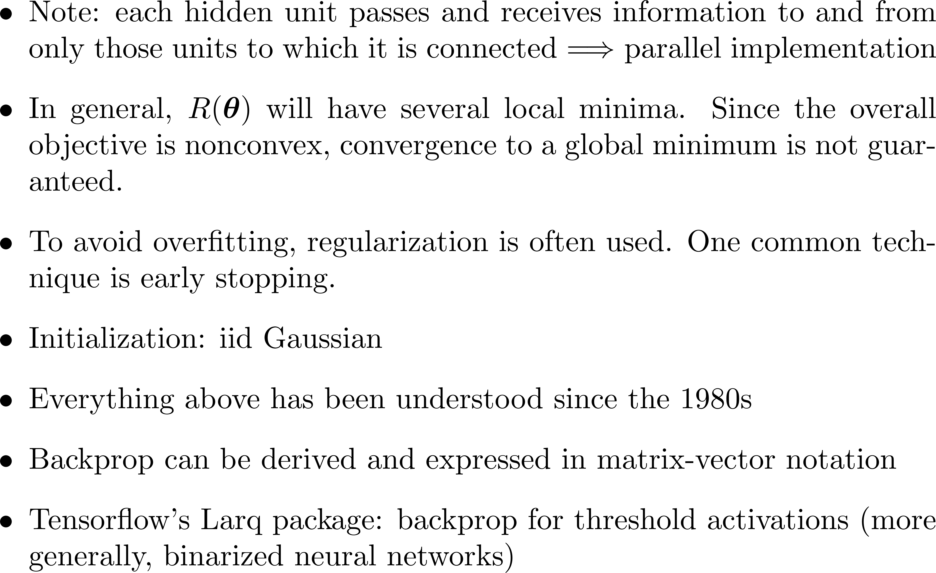
Remarks

